Slide 1



Epilepsy Awareness
Presentation
Epilepsy impacts millions globally, yet myths persist. Join us to learn the facts, support inclusion, and foster a compassionate community.
Get Started

Slide 2
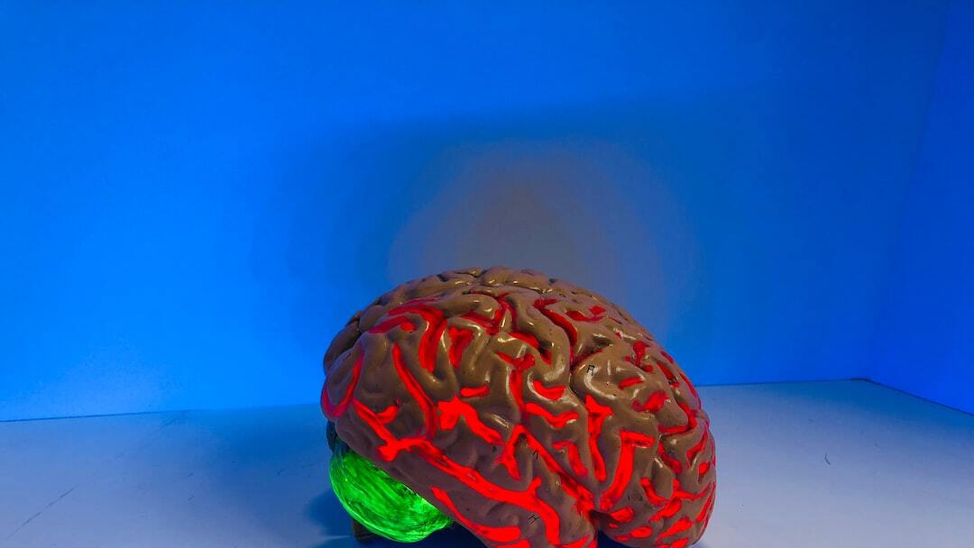
Introduction to Epilepsy
Understanding the Basics
Definition of Epilepsy: A neurological disorder marked by recurrent, unprovoked seizures due to abnormal electrical activity in the brain.
Global Prevalence: Affects over 50 million people worldwide, making it one of the most common neurological disorders.
Impact on Life: Can affect physical safety, mental health, social relationships, and daily activities.
Photo by Natasha Connell on Unsplash
Epilepsy is a common yet often misunderstood neurological condition. It is defined by recurrent, unprovoked seizures caused by disruptions in the brain's electrical activity. Globally, epilepsy affects more than 50 million individuals across all age groups and socioeconomic levels, underscoring its widespread nature. Beyond the seizures themselves, epilepsy has profound effects on everyday life. Individuals may face challenges in education, employment, and personal relationships. The associated stigma and discrimination only add to the emotional toll. Understanding epilepsy is the first step toward effective management and empathy. This presentation will walk you through the key aspects of epilepsy—from identifying seizure types to offering first aid and advocating for inclusive practices.

Slide 3
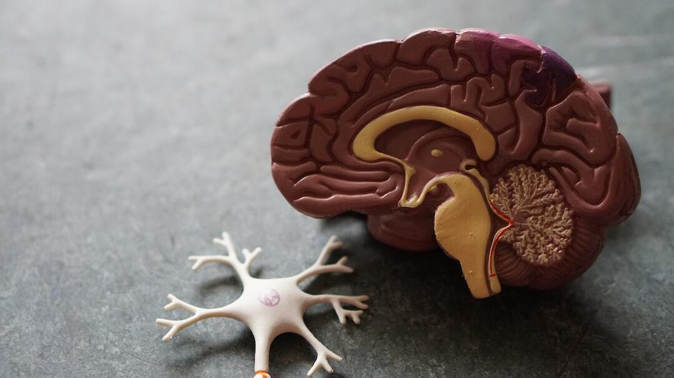
Understanding Seizures
How Seizures Manifest in the Brain
Seizure Definition: Sudden, uncontrolled electrical disturbances in the brain that can cause changes in behavior, movements, feelings, or consciousness.
Focal vs. Generalized: Focal seizures originate in one area of the brain; generalized seizures involve both hemispheres from the start.
Duration and Impact: Seizures typically last from seconds to a few minutes and can range from mild to severe, affecting different bodily functions.
Photo by Robina Weermeijer on Unsplash
To understand epilepsy, it's crucial to first grasp what a seizure actually is. Seizures are sudden surges of electrical activity in the brain that disrupt normal functioning. They can affect behavior, movements, emotions, and levels of consciousness depending on the type and region of the brain involved. There are two broad categories: focal and generalized. Focal seizures start in one part of the brain and may spread, while generalized seizures engage both hemispheres from the onset, often resulting in more noticeable physical symptoms like convulsions. Seizures vary widely in duration and impact. Some may last just a few seconds with minor symptoms, while others may lead to extended periods of unconsciousness or muscle contractions. This variability is one of the key challenges in diagnosis and treatment.

Slide 4
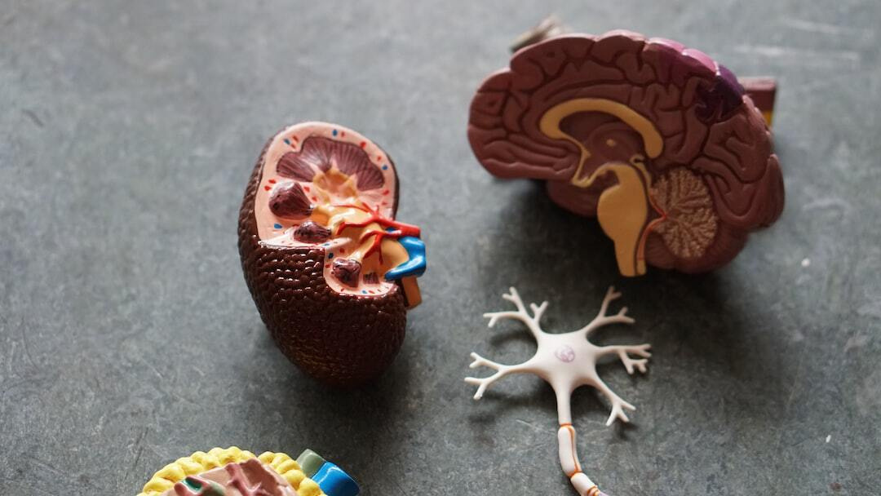
Types of Epilepsy
Diverse Patterns and Diagnoses
Focal Epilepsy: Originates in one specific area of the brain, often identifiable via EEG and imaging.
Generalized Epilepsy: Involves both hemispheres from onset, typically leading to widespread physical symptoms.
Combined and Unknown: Some cases present mixed features or have undetermined origins, complicating diagnosis.
Photo by Robina Weermeijer on Unsplash
Epilepsy encompasses various subtypes, each with unique patterns and implications. A primary distinction lies between focal and generalized epilepsy. Focal epilepsy originates in a specific region of the brain, and often, modern neuroimaging and EEG tests help pinpoint its origin. Symptoms depend heavily on which part of the brain is affected. In contrast, generalized epilepsy starts across both hemispheres simultaneously. It usually causes more overt symptoms, such as convulsions or sudden loss of consciousness, and can be more disruptive to daily functioning. However, not all cases fit neatly into one category. Some people exhibit a combination of both focal and generalized traits, while others have epilepsy of unknown origin, making diagnosis and treatment more complex. Recognizing the type of epilepsy is critical to tailoring effective treatment plans.

Slide 5
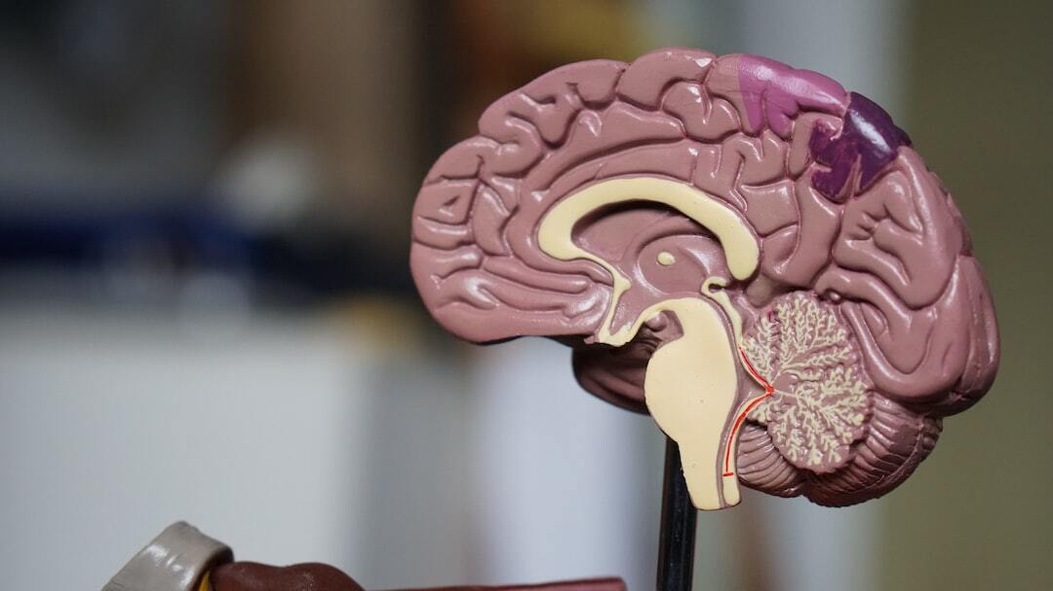
Causes and Risk Factors
Why Epilepsy Develops
Genetic Factors: Certain gene mutations can increase susceptibility to epilepsy, often seen in familial cases.
Brain Injury: Traumatic brain injury, stroke, and tumors are major contributors to acquired epilepsy.
Infections and Other Risks: Neuroinfections like meningitis, and prenatal factors such as hypoxia or developmental disorders, are also significant risks.
Photo by Robina Weermeijer on Unsplash
The causes of epilepsy are multifaceted, ranging from genetic predispositions to environmental insults. Genetics play a substantial role, particularly in cases where there is a family history. Specific gene mutations may alter brain function and increase seizure susceptibility. Acquired causes are just as impactful. Traumatic brain injuries, strokes, and brain tumors can disrupt normal neural pathways, leading to seizure activity. These are often seen in adult-onset epilepsy. Neuroinfections such as meningitis, encephalitis, and even prenatal complications like hypoxia or maternal drug use can also contribute. Identifying the root cause not only helps with diagnosis but also informs the most effective treatment strategy.

Slide 6
Diagnosis and Monitoring
Techniques and Tools to Identify Epilepsy
Electroencephalogram (EEG)
Measures electrical activity in the brain and is the most common test used to diagnose epilepsy.
Neuroimaging
MRI and CT scans help identify structural brain abnormalities causing seizures.
Long-Term Monitoring
Video-EEG and ambulatory monitoring are used to correlate physical symptoms with brain activity.
Accurate diagnosis of epilepsy is essential for effective treatment. One of the most critical tools is the electroencephalogram, or EEG. This test records electrical activity in the brain and helps pinpoint abnormal patterns associated with seizures. It remains the gold standard in epilepsy diagnosis. Imaging techniques such as MRI and CT scans provide complementary insights. These scans detect structural abnormalities like brain tumors, scarring, or lesions that might be triggering seizures. Combining EEG with imaging creates a comprehensive view of brain health. For more complex cases, long-term monitoring—including video-EEG and ambulatory devices—helps observe seizure activity in real-life settings. This kind of detailed data is especially useful for tailoring treatment plans to each patient’s specific needs.

Slide 7
Treatment Options
Managing and Controlling Epilepsy
Antiepileptic Drugs (AEDs)
First-line treatment; about 70% of patients achieve seizure control with medication.
Surgical Interventions
For drug-resistant epilepsy, procedures like lobectomy or laser ablation may be effective.
Device-Based Therapies
Vagus nerve stimulation (VNS), responsive neurostimulation (RNS), and deep brain stimulation (DBS) offer alternatives.
Treatment for epilepsy has evolved significantly, offering various options tailored to the individual's condition and response to therapy. The cornerstone of epilepsy management is antiepileptic drugs (AEDs). These medications work by stabilizing electrical activity in the brain, and about 70% of individuals can achieve seizure control with proper use. For the remaining 30% who experience drug-resistant epilepsy, surgical options become vital. Surgeries like temporal lobectomy or more targeted interventions such as laser ablation can remove or disconnect the seizure-generating brain areas. Technology also plays a growing role. Device-based therapies such as vagus nerve stimulation (VNS), responsive neurostimulation (RNS), and deep brain stimulation (DBS) provide alternative or supplementary treatments. These devices monitor brain activity and respond in real-time to prevent seizures or reduce their severity.

Slide 8
Living with Epilepsy
Strategies for Daily Life and Wellbeing
Lifestyle Adjustments
Adequate sleep, stress management, and avoiding seizure triggers are key to stability.
Medication Adherence
Taking medications consistently and as prescribed is critical for seizure control.
Support Networks
Community groups, counseling, and informed caregivers improve quality of life.
Living with epilepsy involves more than just managing seizures—it’s about maintaining a high quality of life. Simple yet essential lifestyle changes can make a huge difference. Getting regular sleep, managing stress, and avoiding known triggers like flashing lights or alcohol can reduce seizure frequency. Equally important is adherence to prescribed medication. Skipping doses or altering the medication schedule can lead to breakthrough seizures. This is especially crucial for individuals who rely solely on pharmacological control. Lastly, emotional and social support cannot be underestimated. Support groups, therapy, and well-informed friends and family provide a foundation for resilience and empowerment. Living with epilepsy is entirely manageable with the right strategies, care, and community.

Slide 9
First Aid for Seizures
Immediate Steps to Ensure Safety
Stay Calm and Protect
Ease the person to the ground, clear nearby objects, and place something soft under the head.
Do Not Restrain
Do not hold the person down or put anything in their mouth during a seizure.
Time and Monitor
Time the seizure; call emergency services if it lasts over 5 minutes or the person is injured.
Knowing how to respond during a seizure can make a critical difference in someone’s safety. The first rule is to stay calm. Gently guide the person to the ground and remove objects nearby that could cause injury. If possible, place something soft under their head to cushion any movements. It’s essential **not** to restrain the individual or place anything in their mouth—common myths that can lead to harm. The person is not swallowing their tongue, and inserting objects can damage their mouth or teeth. Keep an eye on the time. If the seizure lasts more than five minutes, or if it’s their first seizure, call emergency services immediately. Monitoring them closely and staying with them until full recovery ensures their safety and comfort.

Slide 10
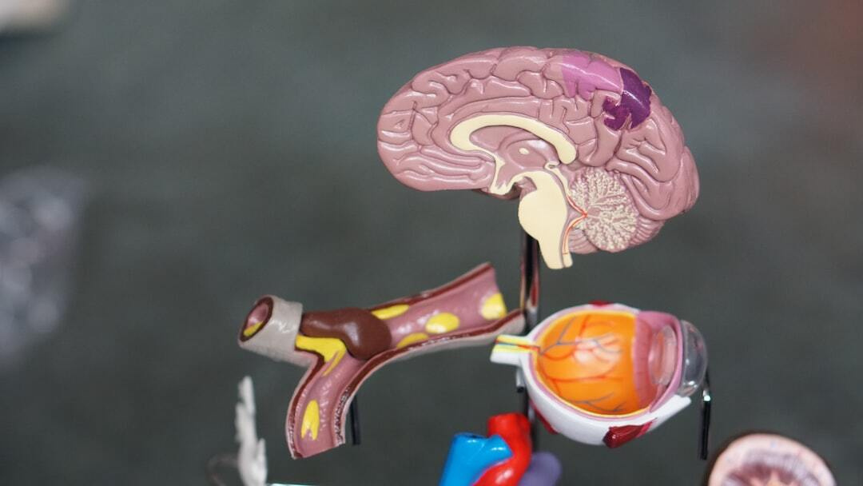
Myths vs. Facts
Correcting Common Misconceptions
Myth: Epilepsy is Contagious: Fact: Epilepsy is a neurological condition and cannot be spread from person to person.
Myth: You Should Hold Someone Down: Fact: Restraining a person during a seizure can cause harm; it's important to let the seizure run its course.
Myth: People with Epilepsy Cannot Live Normal Lives: Fact: With treatment and support, many lead full, productive lives.
Photo by Robina Weermeijer on Unsplash
Epilepsy is surrounded by many persistent myths that contribute to stigma and misunderstanding. One of the most damaging myths is that epilepsy is contagious. This is categorically false—epilepsy is a neurological disorder, not a communicable disease. Another widespread misconception is that during a seizure, someone should be restrained or have objects inserted in their mouth. Both actions can result in physical harm and should be avoided. Instead, focus on protecting the individual and timing the seizure. A third myth is that individuals with epilepsy can't lead normal lives. In truth, with the right medical treatment and a supportive environment, many people with epilepsy pursue careers, start families, and live fully independent lives. Dispelling these myths is crucial for creating a more informed and inclusive society.

Slide 11
Epilepsy and Mental Health
Psychological Dimensions of the Disorder
Increased Risk of Depression
People with epilepsy are 2–3 times more likely to experience depression and anxiety disorders.
Stigma and Isolation
Social stigma and misconceptions can lead to feelings of shame and exclusion.
Integrated Care Needed
Mental health support should be integrated into epilepsy management for holistic treatment.
Epilepsy doesn't only impact physical health—it significantly affects mental and emotional well-being. Studies show that individuals with epilepsy are 2 to 3 times more likely to suffer from depression and anxiety compared to the general population. These psychological conditions can, in turn, worsen seizure control and overall health outcomes. Stigma plays a major role in this dynamic. Misunderstandings about epilepsy often lead to social isolation, job discrimination, and educational barriers. This exclusion can deeply affect a person’s self-esteem and sense of identity, fueling a vicious cycle of mental health challenges. To effectively support individuals with epilepsy, mental health care must be integrated into their treatment plans. This includes counseling, support groups, and, where necessary, medication for mental health conditions. A holistic approach is vital for fostering resilience and long-term wellbeing.

Slide 12

Creating Epilepsy-Safe Environments
Safety Protocols at Home, School, and Work
Home Adjustments: Install cushioned furniture, avoid sharp edges, and use monitoring devices as needed.
School and Work Accommodations: Educate peers, provide quiet spaces, and establish seizure response protocols.
Emergency Preparedness: Train family and coworkers in seizure first aid and maintain updated medical information.
Photo by Nelly Antoniadou on Unsplash
Creating safe environments for individuals with epilepsy is essential for preventing injury and promoting independence. At home, simple modifications like cushioned furniture, corner guards, and avoiding open flames or high-risk areas like stairs can make a big difference. Devices that detect seizures and alert caregivers also add a layer of safety. In schools and workplaces, education is key. Awareness campaigns and training help peers understand epilepsy and respond appropriately. Providing quiet areas for recovery and adapting workloads when needed ensures an inclusive environment. Emergency preparedness is equally vital. Everyone in close contact with someone who has epilepsy should be trained in seizure first aid. Up-to-date emergency contacts, medical records, and a plan of action can reduce panic and improve outcomes when a seizure occurs.

Slide 13

Advocacy and Support Resources
Empowering People with Epilepsy
Awareness Campaigns: Public events and social media efforts reduce stigma and increase understanding.
Community Organizations: Groups like the Epilepsy Foundation provide resources, support groups, and legal guidance.
Policy and Legal Advocacy: Work to influence health policy, anti-discrimination laws, and insurance coverage protections.
Photo by Randalyn Hill on Unsplash
Raising awareness and supporting individuals with epilepsy doesn't stop at treatment—it involves creating systemic change through advocacy and community action. Awareness campaigns are essential tools to dispel myths and foster inclusivity. These campaigns range from social media initiatives to public awareness walks and school programs. Organizations such as the Epilepsy Foundation and international equivalents offer more than just information. They connect individuals to support groups, provide educational materials, and even assist with navigating legal or workplace discrimination. Policy advocacy is another critical pillar. Advocates push for legislation that protects individuals with epilepsy from discrimination, improves access to treatment, and ensures coverage for essential services. Everyone—from patients and caregivers to healthcare professionals and lawmakers—has a role to play in driving this movement forward.

Slide 14
Conclusion and Call to Action
Promoting Awareness, Safety, and Support
Educate and Inform
Share accurate knowledge to dispel myths and encourage understanding.
Support Advocacy Efforts
Engage in local and global campaigns to drive policy and awareness.
Be a Safe Ally
Learn seizure first aid and create inclusive, safe environments.
As we conclude this Epilepsy Awareness Presentation, it's important to recognize that knowledge is power. Educating yourself and others about epilepsy helps break down the stigma and builds a more inclusive society. Sharing accurate information can change perceptions and lives. Supporting advocacy efforts—whether by joining awareness campaigns, fundraising, or writing to lawmakers—strengthens the community and pushes forward vital changes in policy and healthcare access. Finally, you can make a personal impact. Learn seizure first aid, make your spaces safer, and support those around you with empathy and respect. Every action matters, and every voice contributes to the movement for epilepsy awareness and equality.

Slide 15
Thank
You

